Slide 1
Object Oriented Programming ICT-1203
Dr. Jesmin Akhter Associate Professor, IIT, JU
1

Slide 2
Exception Handling-2
2

Slide 3
Multiple catch Clauses
In some cases, more than one exception could be raised by a single piece of code.
To handle this type of situation, you can specify two or more catch clauses, each catching a different type of exception.
When an exception is thrown, each catch statement is inspected in order, and the first one whose type matches that of the exception is executed.
After one catch statement executes, the others are bypassed, and execution continues after the try / catch block.
3

Slide 4
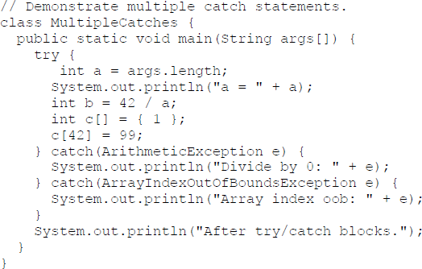
Multiple catch Clauses : Example 1
4

Slide 5
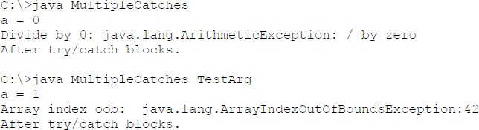
Multiple catch Clauses
The output generated by running it both ways:
5

Slide 6
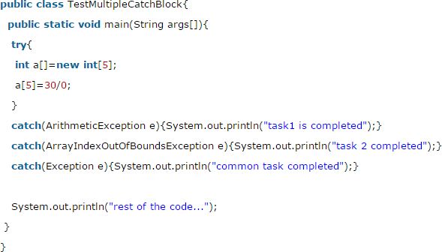
Multiple catch Clauses: Example 2
Output:
task1 completed rest of the code...
6

Slide 7
Multiple catch Clauses
Rule 1: At a time only one Exception is occurred and at a time only one catch block is executed.
Rule 2: When you use multiple catch statements, it is important to remember that exception subclasses must come before any of their super-classes.

Slide 8
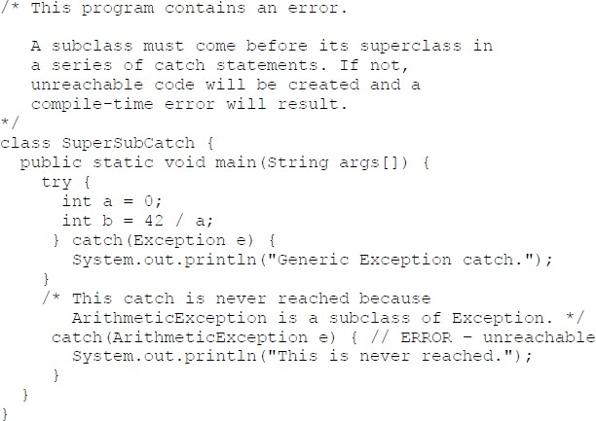
Multiple catch Clauses

Slide 9
Multiple catch Clauses
If you try to compile this program, you will receive an error message stating that the second catch statement is unreachable because the exception has already been caught.
Since ArithmeticException is a subclass of Exception, the first catch statement will handle all Exception- based errors, including ArithmeticException.
This means that the second catch statement will never execute. To fix the problem, reverse the order of the catch statements.

Slide 10
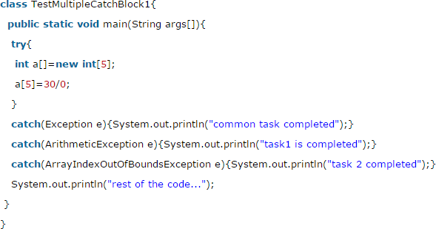
Multiple catch Clauses
Output:
Compile-time error
Because ArithmeticException and ArrayIndexOutOfBoundsException is a sub class of Exception

Slide 11
Nested try Statements
The try block within a try block is known as nested try block in java.
Why use nested try block:
Sometimes a situation may arise where a part of a block may cause one error and the entire block itself may cause another error. In such cases, exception handlers have to be nested.

Slide 12
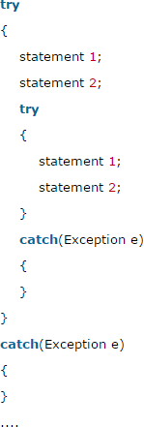
Syntax:

Slide 13
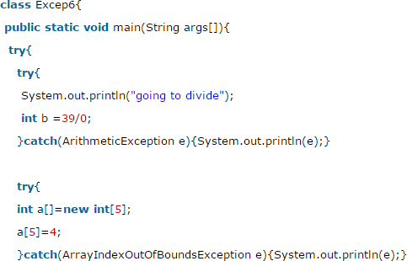
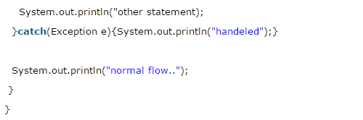

Slide 14
Thank you

